Slide 1
Pointers in C

Slide 2
Pre-requisite
Basics of the C programming language
  Data type
  Variable
  Array
  Function call
  Standard Input/Output
    e.g. printf(), scanf()
Notes:
Due to the nature of this event, I am expecting some prior knowledge in the C programming language such as...

Slide 3
Computer Memory Revisited
Computers store data in memory slots
Each slot has an unique address
Variables store their values like this:
Addr | Content | Addr | Content | Addr | Content | Addr | Content
1000 | i: 37 | 1001 | j: 46 | 1002 | k: 58 | 1003 | m: 74
1004 | a[0]: ‘a’ | 1005 | a[1]: ‘b’ | 1006 | a[2]: ‘c’ | 1007 | a[3]: ‘\0’
1008 | ptr: 1001 | 1009 | … | 1010 |  | 1011

Slide 4
Computer Memory Revisited
Altering the value of a variable is indeed changing the content of the memory
  e.g. i = 40; a[2] = ‘z’;
Addr | Content | Addr | Content | Addr | Content | Addr | Content
1000 | i: 40 | 1001 | j: 46 | 1002 | k: 58 | 1003 | m: 74
1004 | a[0]: ‘a’ | 1005 | a[1]: ‘b’ | 1006 | a[2]: ‘z’ | 1007 | a[3]: ‘\0’
1008 | ptr: 1001 | 1009 | … | 1010 |  | 1011
Notes:
Is there any questions so far?

Slide 5
What is Pointer
A pointer is a variable that stores memory address.
It has name, data types and has to be declared.
It is called pointer because it points to a particular location in memory by storing the address of that location.
Declaration: data_type *pname;

Slide 6
float *I;
int *ptr; /* declare a pointer variable */
FIGURE 9-10 Pointer Variable Declaration

Slide 7
Addressing Concept
Pointer stores the address of another entity
It refers to a memory location. “ &” is used to assign the address to a pointer.
int i=30;
int *ptr;
ptr = &i; /* store address-of i to ptr */
Notes:
As its name suggests, … Syntactically, a pointer variable is declared as a type identifier followed by an asterisk “*”.

Slide 8
What actually ptr is?
ptr is a variable storing an address
ptr is NOT storing the actual value of i
int i = 5;
int *ptr;
ptr = &i;
printf(“i = %d\n”, i);
printf(“*ptr = %d\n”, *ptr);
printf(“ptr = %u\n”, ptr);
ptr
address of i
i
5
Output:
i = 5
*ptr = 5
ptr = effff5e0
value of ptr = address of i
in memory
Notes:
This code segment appeared in the appetizer.

Slide 9
Twin Operators
“&” : Address-of operator
  Get the address of an variable
    e.g. ptr = &j;
Addr | Content | Addr | Content | Addr | Content | Addr | Content
1000 | i: 40 | 1001 | j: 33 | 1002 | k: 58 | 1003 | m: 74
1004 | ptr: 1001 | 1005 |  | 1006 |  | 1007

Slide 10
Twin Operators
“*” : De-reference operator
  Refer to the content of the referee
    e.g. *ptr = 99;
Addr | Content | Addr | Content | Addr | Content | Addr | Content
1000 | i: 40 | 1001 | j: 99 | 1002 | k: 58 | 1003 | m: 74
1004 | ptr: 1001 | 1005 |  | 1006 |  | 1007

Slide 11
Example: Pass by Reference
Modify behaviour in argument passing
void f(int j)
{
j = 5;
}
void g()
{
int i = 3;
f(i);
}
void f(int *ptr)
{
*ptr = 5;
}
void g()
{
int i = 3;
f(&i);
}
i = ?
i = 3
i = ?
i = 5
Notes:
The program segment on the left is demonstrating “pass by value”, i.e. the value, actually a copy, of the variable i is passed as argument to function f(). The other program shows you “pass by reference”. The address of the variable i is passed to f() instead, thus allowing us to modify the content stored in the variable.

Slide 12
Pointer Arithmetic
All types of arithmetic operation are not possible with pointers.
Valid operation with pointers:
Addition of an integer to a pointer and increment operation.
Subtraction of an integer from a pointer and decrement operation
Subtraction of a pointer from another pointer of same type.
All arithmetic is performed relative to the size of base type of pointer.

Slide 13
Pointer Arithmetic
What’s ptr + 1?
The next memory location!
What’s ptr - 1?
The previous memory location!
What’s ptr * 2 and ptr / 2?
Invalid operations!!!
Can never performed on pointers –
Addition, multiplication, division of two pointers.
Multiplication between pointer and any number.
Division of pointer by any number.
Addition of float or double values to pointers.

Slide 14
int a=5, *pi = &a;
float b= 2.2, *pf = &b;
char c = ‘x’, *pc = &c;
Suppose address of variable a, b and c are 1000, 4000, 5000 respectively. So initially value of pi, pf and pc are 1000, 4000 and 5000.
pi++ or ++pi; pi = 1000+2 = 1002 (since int is a 2byte)
pi = pi - 3; pi = 1002 – 3*2 = 996
pi = pi + 5; pi = 996+ 5* 2= 1006
pi– or –pi; pi = 1006 -2 = 1004
pf++ or +pf; pf = 4000+4 = 4004 (Since float is of 4 byte)
pc++ or ++pc; pc = 5000+1 = 5001 (Since char is of 1 byte )

Slide 15
Precedence of dereferencing operator and increment decrement operator
The precedence level of * operator and increment/decrement operators is same and their associativity is from right to left.
Suppose ptr is an integer pointer and x is an integer variable
ptr →
x = *ptr++ = *ptr++ ==> *(ptr++) o/p x= 25
x = *++ptr = *++ptr ==> *(++ptr) o/p x=38
x= ++ *ptr = ++*ptr ==> ++(*ptr) o/p x = 26
x = (*ptr)++ o/p x= 25
25 38

Slide 16
Pointer to pointer
We can store the address of a pointer variable in some other variable, which is known as a pointer to pointer variable.
The syntax of declaring a pointer to pointer is as-
data_type **pptr;
double asterisk used in the declaration of pointer to pointer.
int a= 5 ;
int *pa = &a;
int **ppa = &a;
4000 3000 2000
ppa pa a
3000
2000
5

Slide 17
An Illustration
int i = 5, j = 10;
int *ptr;
int **pptr;
ptr = &i;
pptr = &ptr;
*ptr = 3;
**pptr = 7;
ptr = &j;
**pptr = 9;
*pptr = &i;
*ptr = -2;
Data Table
Name | Type | Description | Value
i | int | integer variable | 5
j | int | integer variable | 10

Slide 18
An Illustration
int i = 5, j = 10;
int *ptr; /* declare a pointer-to-integer variable */
int **pptr;
ptr = &i;
pptr = &ptr;
*ptr = 3;
**pptr = 7;
ptr = &j;
**pptr = 9;
*pptr = &i;
*ptr = -2;
Data Table
Name | Type | Description | Value
i | int | integer variable | 5
j | int | integer variable | 10
ptr | int * | integer pointer variable

Slide 19
An Illustration
int i = 5, j = 10;
int *ptr;
int **pptr; /* declare a pointer-to-pointer-to-integer variable */
ptr = &i;
pptr = &ptr;
*ptr = 3;
**pptr = 7;
ptr = &j;
**pptr = 9;
*pptr = &i;
*ptr = -2;
Data Table
Name | Type | Description | Value
i | int | integer variable | 5
j | int | integer variable | 10
ptr | int * | integer pointer variable
pptr | int ** | integer pointer pointer variable
Double Indirection

Slide 20
An Illustration
int i = 5, j = 10;
int *ptr;
int **pptr;
ptr = &i; /* store address-of i to ptr */
pptr = &ptr;
*ptr = 3;
**pptr = 7;
ptr = &j;
**pptr = 9;
*pptr = &i;
*ptr = -2;
Data Table
Name | Type | Description | Value
i | int | integer variable | 5
j | int | integer variable | 10
ptr | int * | integer pointer variable | address of i
pptr | int ** | integer pointer pointer variable
*ptr | int | de-reference of ptr | 5

Slide 21
An Illustration
int i = 5, j = 10;
int *ptr;
int **pptr;
ptr = &i;
pptr = &ptr; /* store address-of ptr to pptr */
*ptr = 3;
**pptr = 7;
ptr = &j;
**pptr = 9;
*pptr = &i;
*ptr = -2;
Data Table
Name | Type | Description | Value
i | int | integer variable | 5
j | int | integer variable | 10
ptr | int * | integer pointer variable | address of i
pptr | int ** | integer pointer pointer variable | address of ptr
*pptr | int * | de-reference of pptr | value of ptr (address of i)

Slide 22
An Illustration
int i = 5, j = 10;
int *ptr;
int **pptr;
ptr = &i;
pptr = &ptr;
*ptr = 3;
**pptr = 7;
ptr = &j;
**pptr = 9;
*pptr = &i;
*ptr = -2;
Data Table
Name | Type | Description | Value
i | int | integer variable | 3
j | int | integer variable | 10
ptr | int * | integer pointer variable | address of i
pptr | int ** | integer pointer pointer variable | address of ptr
*ptr | int | de-reference of ptr | 3

Slide 23
An Illustration
int i = 5, j = 10;
int *ptr;
int **pptr;
ptr = &i;
pptr = &ptr;
*ptr = 3;
**pptr = 7;
ptr = &j;
**pptr = 9;
*pptr = &i;
*ptr = -2;
Data Table
Name | Type | Description | Value
i | int | integer variable | 7
j | int | integer variable | 10
ptr | int * | integer pointer variable | address of i
pptr | int ** | integer pointer pointer variable | address of ptr
**pptr | int | de-reference of de-reference of pptr | 7

Slide 24
An Illustration
int i = 5, j = 10;
int *ptr;
int **pptr;
ptr = &i;
pptr = &ptr;
*ptr = 3;
**pptr = 7;
ptr = &j;
**pptr = 9;
*pptr = &i;
*ptr = -2;
Data Table
Name | Type | Description | Value
i | int | integer variable | 7
j | int | integer variable | 10
ptr | int * | integer pointer variable | address of j
pptr | int ** | integer pointer pointer variable | address of ptr
*ptr | int | de-reference of ptr | 10

Slide 25
An Illustration
int i = 5, j = 10;
int *ptr;
int **pptr;
ptr = &i;
pptr = &ptr;
*ptr = 3;
**pptr = 7;
ptr = &j;
**pptr = 9;
*pptr = &i;
*ptr = -2;
Data Table
Name | Type | Description | Value
i | int | integer variable | 7
j | int | integer variable | 9
ptr | int * | integer pointer variable | address of j
pptr | int ** | integer pointer pointer variable | address of ptr
**pptr | int | de-reference of de-reference of pptr | 9

Slide 26
An Illustration
int i = 5, j = 10;
int *ptr;
int **pptr;
ptr = &i;
pptr = &ptr;
*ptr = 3;
**pptr = 7;
ptr = &j;
**pptr = 9;
*pptr = &i;
*ptr = -2;
Data Table
Name | Type | Description | Value
i | int | integer variable | 7
j | int | integer variable | 9
ptr | int * | integer pointer variable | address of i
pptr | int ** | integer pointer pointer variable | address of ptr
*pptr | int * | de-reference of pptr | value of ptr (address of i)

Slide 27
An Illustration
int i = 5, j = 10;
int *ptr;
int **pptr;
ptr = &i;
pptr = &ptr;
*ptr = 3;
**pptr = 7;
ptr = &j;
**pptr = 9;
*pptr = &i;
*ptr = -2;
Data Table
Name | Type | Description | Value
i | int | integer variable | -2
j | int | integer variable | 9
ptr | int * | integer pointer variable | address of i
pptr | int ** | integer pointer pointer variable | address of ptr
*ptr | int | de-reference of ptr | -2

Slide 28
Pointers and functions
The arguments to the function can be passed by two/more ways.
Call by value
Call by reference
In call by value only the value of arguments are sent to the function while in call by reference, addresses of arguments are sent to the function.
In call by value, any change to the formal arguments do not change the actual argument.
In call by reference method, any changes made to the formal arguments change the actual arguments also.
Call by value studied in function.

Slide 29
An unworkable exchange example

Slide 30
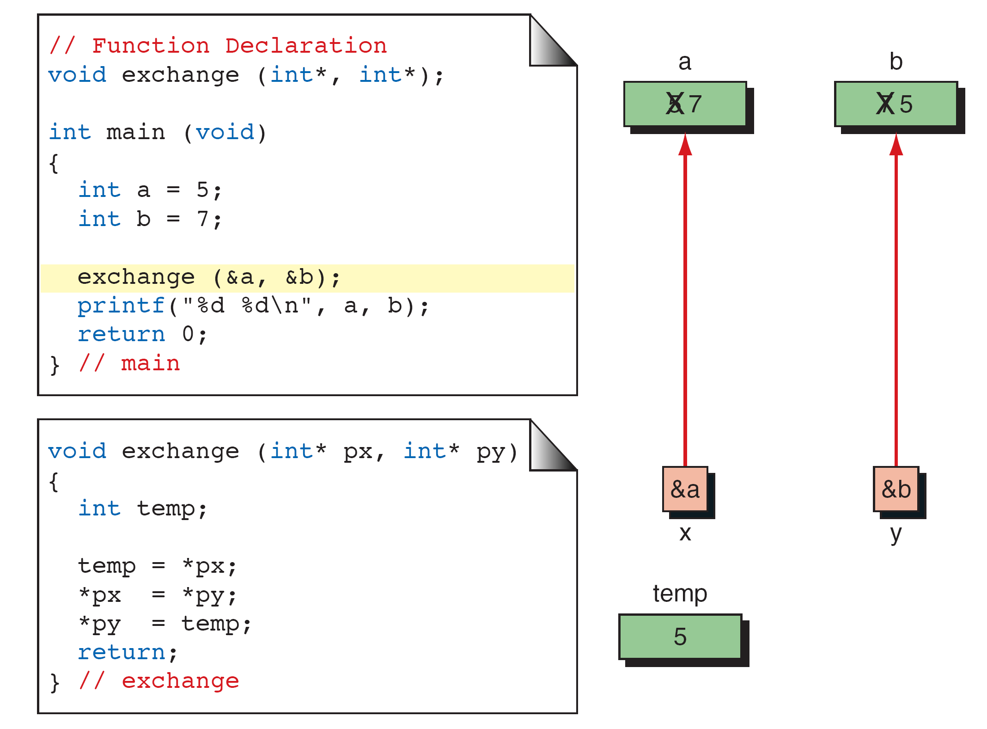
Call by reference with pointer arguments
  Pass address of argument using & operator
  Allows you to change actual location in memory
  Arrays are not passed with & because the array name is already a pointer

Slide 31
Returning more than one value from a function
We can’t return more than one value from a function through return statement.
This limitation can be overcome by using call by reference.
Let us take a simple example to understand this concept.
#include<stdio.h>
#include<conio.h>
func( int, int, int* , int* , int* )
main()
{
int a, b, sum, diff, prod;
a = 6;
b = 4;
func( a, b, &sum, &diff, &prod);

Slide 32
printf (“ sum = %d, difference = %d, product = %d \n “, sum, diff, prod); }
func( int x, int y, int *ps, int *pd, int *pp)
{
*ps = x+y;
*pd = x-y;
*pp = x*y;
}
Output Sum =10, Difference = 2, Product =24

Slide 33
Pointer to structure
C structure can be accessed in 2 ways in a C program. They are,
Using normal structure variable
Using pointer variable
Dot(.) operator is used to access the data using normal structure
variable and arrow (->) is used to access the data using pointer
variable.
You can define a pointer to a structure in the same way as any pointer to any type. For example:
struct emprec *ptr defines a pointer to an emprec.

Slide 34
Accessing structure's member through pointer
A structure's member can be accessed through pointer in two ways:
Referencing pointer to another address to access memory
Using dynamic memory allocation
Consider an example to access structure's member through pointer.
#include <stdio.h>
typedef struct person
{
int age;
float weight;
};

Slide 35
int main()
{
struct person *personPtr, person1;
personPtr = &person1; // Referencing pointer to memory address of person1
printf("Enter integer: ");
scanf("%d",&(*personPtr).age);
printf("Enter number: ");
scanf("%f",&(*personPtr).weight);
printf("Displaying: ");
printf("%d%f",(*personPtr).age,(*personPtr).weight);
return 0;
}
(*personPtr).age is same as personPtr->age (*personPtr).weight is same as personPtr->weight
Enter integer:25 Enter number: 55 Displaying: 25 55.000000

Slide 36
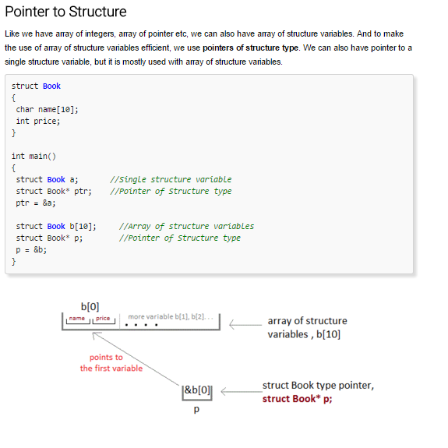

Slide 37
